Slide 1
Applied Computing Slideshows by Mark Kelly vcedata.com mark@vcedata.com
Efficient data handling
V1.1 – 2022-02-28 @ 11:23

Slide 2
Efficient Handling

Slide 3
Handling?
Storage & retrieval
Communication
Processing

Slide 4
Storage & retrieval
Use devices with fast read/write times for data/info that is accessed frequently
HDD, SSD, NAS
Network
Fast cloud connection
Not slow memory keys

Slide 5
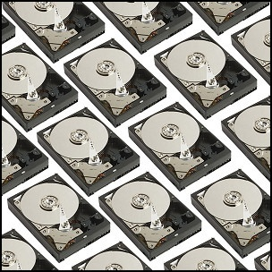
Backup!
Much faster to restore lost data from a backup than it is to re-enter it!
Backup regularly (daily), store backups offsite
Backup procedures should be documented and tested. (Why?)
See the BACKUPS slideshow

Slide 6
Efficient Storage - RAID
RAID (Redundant Array of Independent Disks)
RAID 5 – uses multiple disks as a single unit
Files are striped (split up) across multiple physical disks
File segments are redundantly saved
If a disk fails, redundant copies of file segments from remaining disks can rebuilt the lost disk’s contents

Slide 7
RAID
Can retrieve multiple file segments at the same time from different disks
E.g. a file in 15 segments saved to a single disk takes 15 consecutive write operations.
E.g. striped across 3 disks, the file can be retrieved in only 5 consecutive disk operations
Each of the 3 disks retrieves 5 segments
3 times faster!

Slide 8
Storage Efficiency
Use logical, consistent folder and file naming
Files can be found more quickly
Less chance of losing files

Slide 9
Version Control
Also use file version control to make it clear which document version is newer than or different to another
Allows rolling back to a previous version in case the latest version is found to be a disaster

Slide 10
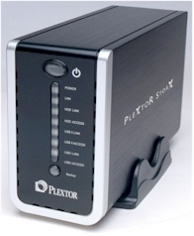
Centralised storage
Don’t save team files to your local PC’s hard disk (except as an informal backup)
Save shared team files centrally so team can get to them from anywhere, at any time
Create a shared network folder
NAS (network attached storage) on a small office/home office LAN
And/or save to the cloud or a secure website

Slide 11
Communication
Over a LAN
Limited to local area
Instant
Massive file capacity
Secure

Slide 12
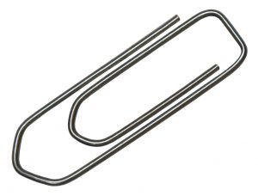
Email attachments, mailing lists
Attachment size may be limited
Can be sent anywhere in the world
Can be very quick to arrive (can be slow too)
Slow to download large attachments

Slide 13
Email attachments, mailing lists
May ‘bounce’ and not be delivered if destination mailbox is full
May be blocked/deleted by spam filter
Good for ‘pushing’ information to people
C.f. “pulling” where people download at will
Return receipts reassure sender that delivery was successful

Slide 14
HTTP
Click a link to download a file from a website
Not too good for really large files or large numbers of files
Just need a a web browser

Slide 15
FTP
File Transfer Protocol
Designed for file transfer
Secure – login can be required
Like a file manager with drag-and-drop
Supports resumption of interrupted downloads
Good for exchanging large or many files
Mainly used by webmasters

Slide 16
Yousendit.com, megaupload.com etc
Allows transfer of very large files
Basic access is free
Secure – can require a login

Slide 17
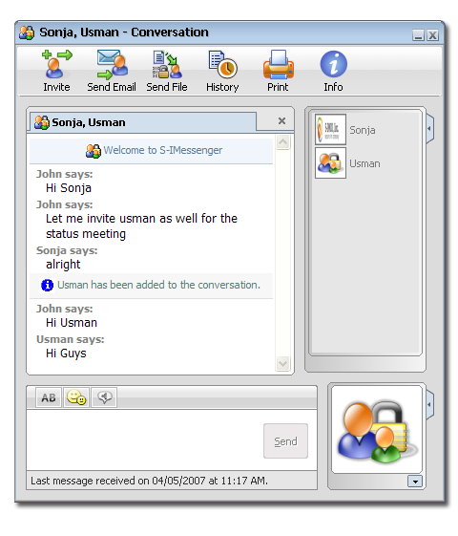
Instant Messaging file transfers
Can exchange files between individuals during live chat
Quick, spontaneous

Slide 18
Communication Overview
Needs to be secure
Login to storage site
Encrypt documents in transit
VPN (Virtual Private Network) is a secure, private, encrypted internet connection
Needs to be fast
Needs to be able to cope with very large files
May be expensive for fast, fat bandwidth

Slide 19
Applied Computing Slideshows
by Mark Kelly
vcedata.com
mark@vcedata.com
These slideshows may be freely used, modified or distributed by teachers and students anywhere on the planet (but not elsewhere).
They may NOT be sold.
They must NOT be redistributed if you modify them.

