Slide 1
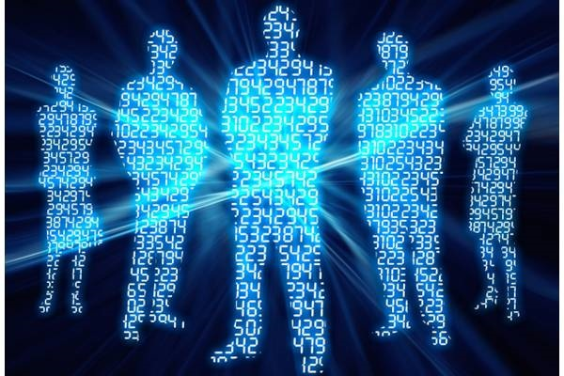
vcedata.com
mark@vcedata.com
Threats to data and information
Threats to data and information
Applied Computing Slideshows
by Mark Kelly

Slide 2
Contents
Deliberate actions
Accidental actions
Technical failure
Events-based
… during …
Storage
Communication
Disposal

Slide 3
Examples
 | Accidental | Deliberate | Tech Failure
Storage | Jostling a computer when HDD is active Damaging a DVD Fire | Illicitly copying data Theft of computer | Hard disk failure Unreliable storage media (e.g. bad DVD) Power failure
Communication | Files/emails are sent to the wrong person | Intercepting private data Infecting files with viruses, trojans | - Damage to packets during transmission
Disposal | - Deleting the wrong file or folder | - Deleting someone’s valuable data

Slide 4
Deliberate Actions
Viruses / worms
Trojans
Rootkits
Malware = Adware, spyware
Theft of computers and data
Espionage
Hackers
Disgruntled employees
Denial of Service attacks
Phishing
Internet scams

Slide 5
Viruses / worms
Viruses attach to EXE files – rare now
Worms travel in email – self-contained. Common now.
Must have reliable antivirus scanner running with up-to-date virus/worm definitions
Free ones (e.g. MS Defender) often just as good as the paid-for ones.

Slide 6
Malware
Malware = ‘Malicious software’ = Adware, spyware
Adware – tracks internet use to target ads at users. Not usually malicious, but often badly written and buggy: slows computers down or crashes them.
Spyware – deliberately, stealthily monitors users’ actions and can redirect web surfing, change internet settings, disable firewalls etc.

Slide 7
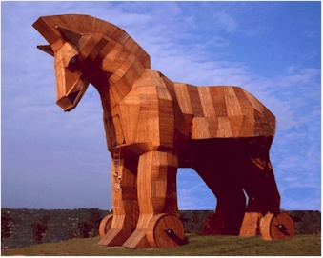
Trojans
Named after the Trojan Horse
Pretends to be harmless software – actually is malicious
Hides itself from detection
Often hidden in illegal downloads
Can be picked up on malicious websites (“drive-by download”)

Slide 8
Trojans (continued)
Trojan “Payload” can include:
Keylogger – steals passwords, credit card #, bank details
Spam server – forces victim PC to send spam
DDOS – becomes ‘zombie computer’ participating in Distributed Denial of Service attack.

Slide 9
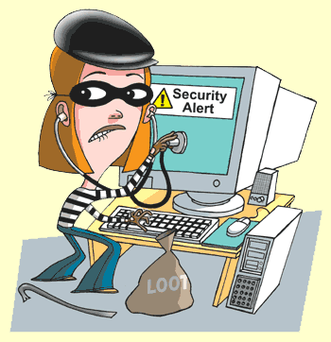
Rootkits
Installed secretly
Very hard to detect and remove – they hide.
Gains very intimate access to operating system
Risky if hacker can take over a rootkit and use its intimate access to the OS for the hacker’s benefit. (This has already happened)

Slide 10
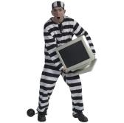
Theft of computers and data
Thieves probably just want the computer, but unique & valuable data is lost with the PC
Sensitive data can be leaked
Laptops, smartphones, USB hard disks, Flash drives are particularly easy to steal (or carelessly leave behind)
Tip: don’t use a laptop bag that makes its contents obvious to everyone.

Slide 11
Prevention
Physical security
fences
locked doors
bars on windows
alarms
video surveillance
fire detectors
fire extinguishers
armed guards
guard dogs
armed guard dogs with fire extinguishers

Slide 12
Prevention
Physical security (continued)
security cables or cradles to bolt down or tie computers to furniture
locks on computer cases so they can't be opened and hard disks removed
glue up USB ports to prevent devices being plugged in
UPS (uninterruptible power supply)
LOCKED DOORS! Simples!

Slide 13
Prevention
Procedural security
Not letting the public near computers
Not letting the public see what’s on the screen
Never logging in with an outsider watching
Shredding all paper waste
Forbidding the use of personal hard disks or USB storage devices (to prevent staff taking valuable data home)

Slide 14
Prevention
Procedural security
Staff hand in their keys before going on holiday
Change passwords regularly – prevent the re-use of old passwords
Never give passwords over the phone or in email
Never open unexpected attachments
Monitor email to detect suspiciously large data exports
Mandate corporate procedures for backups, filenaming.

Slide 15
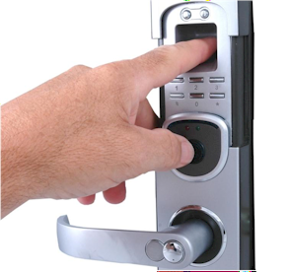
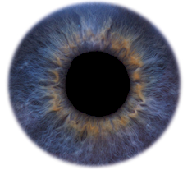
Prevention
Electronic/software security
Usernames and passwords on computer startup, operating system, databases, Office documents
Audit trails
Encryption
Biometric identification

Slide 16
Biometric Identification
Keys and passwords only prove someone possesses the key or password, not that they are entitled to use them.
Keys, passwords etc can be stolen, copied, lost, forgotten – fingerprints, eyes cannot.
Biometric ID ensures that a person requesting access is actually the person who was granted access

Slide 17
Biometric Identification: Unique and unchanging features*
Fingerprints (supposedly – open to debate)
Retinal scans (blood vessels at the back of the eye)
Iris scans (coloured part at the front of the eye)
Hand vein pattern
*Yes – even between identical twins.

Slide 18
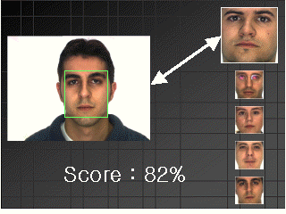
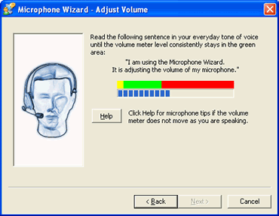
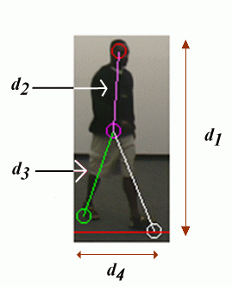
Less reliable biometric features: not unique, or may change over time But can be detected at a distance
Face recognition
You’ve seen lookalikes
Voice recognition
It’s easy to imitate voices
Walk (gait) recognition
Can be rehearsed

Slide 19
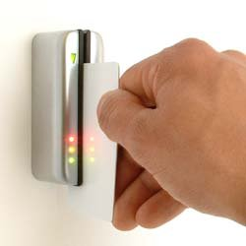
Prevention
Electronic security
Use swipe cards instead of keys
Most hotels use them now
Cards can be deauthorised immediately if lost, or a user becomes a risk
Can be programmed to only open certain doors at certain times of day (e.g. not after 5pm or on weekends or when its user is on holidays)

Slide 20
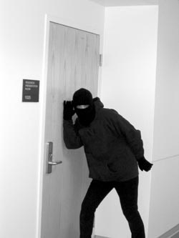
Espionage
Political – can threaten national security
Industrial – steal competitor’s secrets
Encryption can make stolen data useless to unauthorised people. See:
SSL
RSA, PGP
Public Key encryption

Slide 21
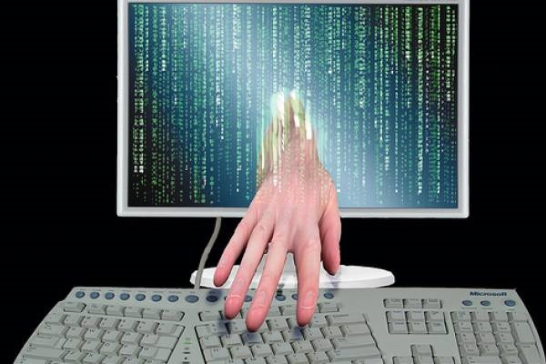
Hackers
Usually now organised crime rings aiming to steal money

Slide 22
Hackers
Hackers can control PCs compromised by
Trojans – steal bank account info, credit card numbers, passwords etc
Will sell the info or use it themselves
Defence = firewall to prevent hacker activating or being reported to by an installed Trojan

Slide 23
Firewalls
Block communication ports that are usually open and can be entered by hackers
Make a computer invisible to port sniffing software
Built into most home routers – good & easy protection from incoming threats

Slide 24
Firewalls
Software firewalls also block unauthorised outgoing traffic (e.g. a trojan mailing its keylogger data back to a hacker)
Software firewalls can need training to teach them what programs are allowed to send data.

Slide 25
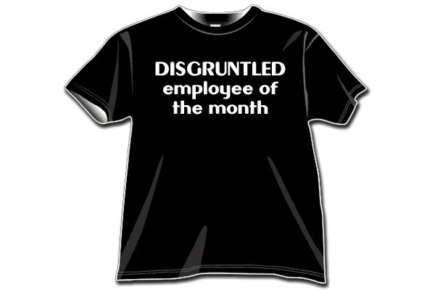
Disgruntled employees
‘Disgruntled’ = sulky, dissatisfied, seeking revenge (e.g. just been fired or yelled at)
Can do harm with carelessness or active malice
May steal data to hurt employer and offer to new employer
Solution: remove network/data access privileges before sacking people!
Audit trails record all network actions & who was responsible.

Slide 26
Distributed Denial of Service attack (DDOS)
Usually set up by a hacker taking control of zombie PCs infected by a Trojan
Hacker can direct many zombies to bombard server with Pings or data requests to the point it can’t cope and cannot work properly

Slide 27
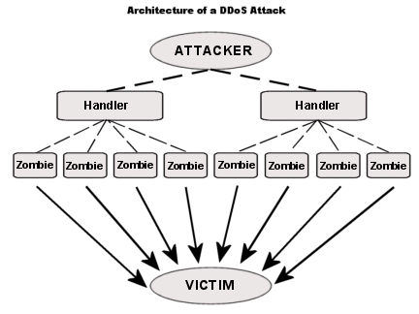
DDOS attack
DDOS are often aimed at commercial, political, religious, or personal enemies
Not many defences against DDOS: keep server’s NOS up to date and security holes patched.

Slide 28
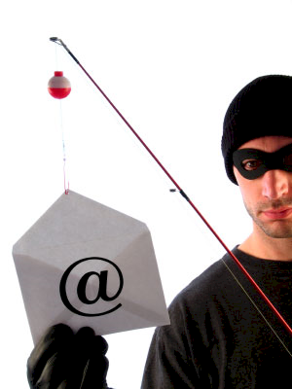
Phishing
‘Social engineering’
Depends on gullibility of victims
Often uses scare tactics, e.g.
Your bank account has been compromised
This (fake) Paypal transaction has happened. Click here to find out more.
You need to verify your login
‘Spear Phishing’ – a phishing attack aimed at a specific victim

Slide 29
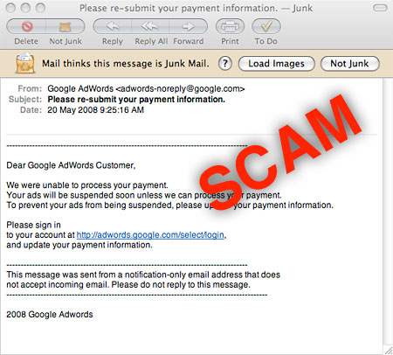
Phishing
Can be convincing – fake website logins look real
Solution: educate employees; never click a link in a suspicious email

Slide 30
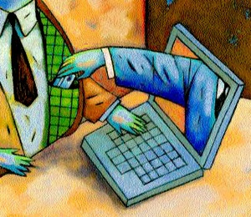
Internet scams
Rely on victim’s humanity (e.g. fake charities) or greed (e.g. Nigerian ‘419’ scam)
People give bank account info or donate directly
Solution: educate users; don’t believe ‘too good to be true’ offers

Slide 31
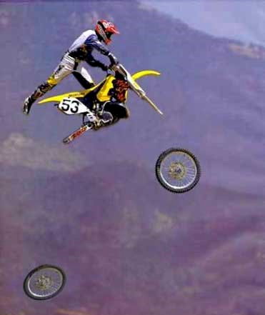
Accidental actions
Incompetent employees
"Misplaced" data
Natural disasters

Slide 32
Incompetent employees
One of the most common threats to data
Poorly-trained staff destroy more data than any number of hackers
Good intentions won’t bring back deleted data
Train users fully; give good documentation

Slide 33
Incompetent employees
Only give users enough access to data so they can do their job.
Hierarchical data access – limits the damage they can do
Use good software that makes mistakes harder to make

Slide 34
"Misplaced" data
Poor file handling procedures can lead to files being impossible to find without huge searches
May not be destroyed, but data is equally inaccessible.
Solution: properly planned and enforced file and folder naming scheme
Version control – to prevent overwriting recent documents with old data.

Slide 35
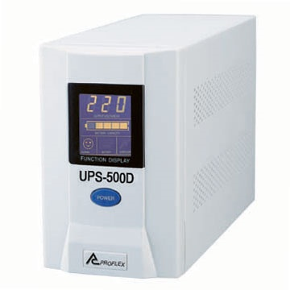
‘Natural’ disasters
E.g. fire, flood, earthquake, falling tree, runaway truck, power surge, riot, war, lightning
Uninterruptible Power Supply (UPS) can filter out dangerous power surges to protect hardware, and cope with blackouts
Disaster may not be preventable, but can be recovered from with a good data disaster recovery plan…

Slide 36
Disaster Recovery Plan
Relies on backups.
Effective backups must be:
Regular (incremental daily, full backup weekly)
Tested (with sample data, not real data!)
Stored offsite
Key recovery info should also be stored offsite
Insurance company, policy number etc
Details of backup software and hardware to allow restore
etc

Slide 37
Disaster Recovery Plan
Any DRP must be tested to find weaknesses or omissions
Perform test restores of backed up data
Practice fire drills
Ensure that the emergency administrator password works
Test smoke alarms, burglar alarms
Ensure emergency contacts list is up to date
etc

Slide 38
Technical Failure
Hardware failure (e.g. hard disk crash, file server failure)
Operating system failure
Software failure

Slide 39
Hardware Failure
Typically: hard disk, power supplies (moving parts age quickly), solder joints on motherboards dry out and break)
Solution: redundant equipment (e.g. two power supplies, NICs)
Solution: good environment
Air conditioned server room
UPS to prevent power surges

Slide 40
Software Failure
OS crash or application failure can cause data loss if work in progress has not been saved recently
Not likely to damage any hardware
Can waste time and cause annoyance
Solution: save frequently! Backup the entire data set frequently.

Slide 41
Consequences of ignoring safety measures
Loss of valuable data that can’t be replaced at all, or only with huge effort and cost
Competitors finding out your secrets
Damage to or loss of expensive equipment
Financial loss through misuse of credit cards or bank accounts

Slide 42
Consequences
Unwitting participation in illegal actions such as spamming or DDOS attacks
Loss of reputation through negligently letting customer information go public
Penalties by the tax office for not having proper GST or tax records
Prosecution under the Privacy Act if sensitive information is not properly protected.

Slide 43
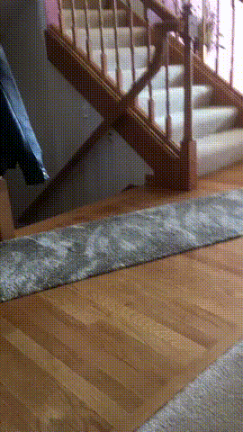
If you are getting bored
Here is a picture of a pussy cat.

Slide 44
Consequences
Loss of income when unable to do business due to system failure
Total failure of the organisation after catastrophic data loss
Organisational death.

Slide 45
Remember
No system is 100% invulnerable
If someone is sufficiently determined to get in, they will
No one protection measure is perfect
A combination of simple measures is very powerful…

Slide 46
Remember
Implement protection against the most likely risks:
Do good backups
Lock doors
Use strong passwords
Run antivirus software
Use a router and firewall
Train staff against phishing and opening attachments
Such simple measures will mean 99.99% protection

Slide 47
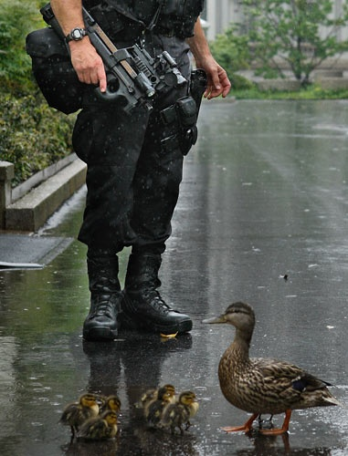
Remember
Recommend sensible strategies that are appropriate to the organisation in the case study.
Don’t invent outlandish, unlikely risks that are not in the case study.
Forget the 24x7 armed guard protecting the fish & chip shop’s PC.
Forget the ceiling-mounted lasers

Slide 48
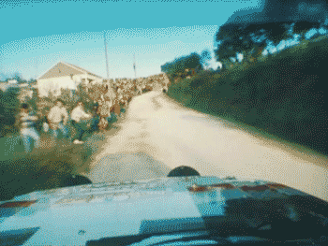
Because you’ve been good here’s a picture you can look at

Slide 49
Applied Computing Slideshows
by Mark Kelly
vcedata.com
mark@vcedata.com
These slideshows may be freely used, modified or distributed by teachers and students anywhere on the planet (but not elsewhere).
They may NOT be sold.
They must NOT be redistributed if you modify them.

